Slide 1

CMPP 257
Introduction to JavaScript & JQuery
Module 5: Event Handlers & Forms
Dr. Hamdy Ibrahim
CMPP 257: Introduction to JavaScript & JQuery

Slide 2
Outlines
Events Handling
  Event Definition
  Event Handling?
  Steps of Developing Event-Driven Website.
  Event Types.
  Event Handlers: Examples
Form Manipulation
CMPP 257: Introduction to JavaScript & JQuery

Slide 3

Event Handlers: Concepts
Event
Things a User or Browser Does
User-Related Events → Clicking a Mouse
Browser-Related Events → Updating Clock, Loading Page
Firing an Event → The Event Happens
CMPP 257: Introduction to JavaScript & JQuery

Slide 4
Event Handlers: Concepts
Event Handling
Capturing Events and Responding to Them
Script Reaction (e.g., Function Call ) as a Result of Event Firing
Reaction to User Actions → Interactive Website
Event-Driven Scripts: Scripts with the Ability to Capture and Respond to Events
CMPP 257: Introduction to JavaScript & JQuery

Slide 5
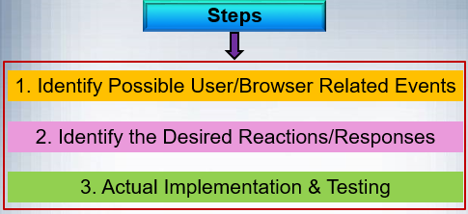
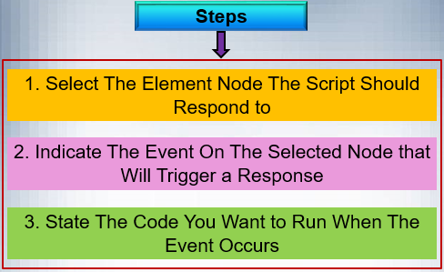
Event Handlers: Steps
CMPP 257: Introduction to JavaScript & JQuery

Slide 6
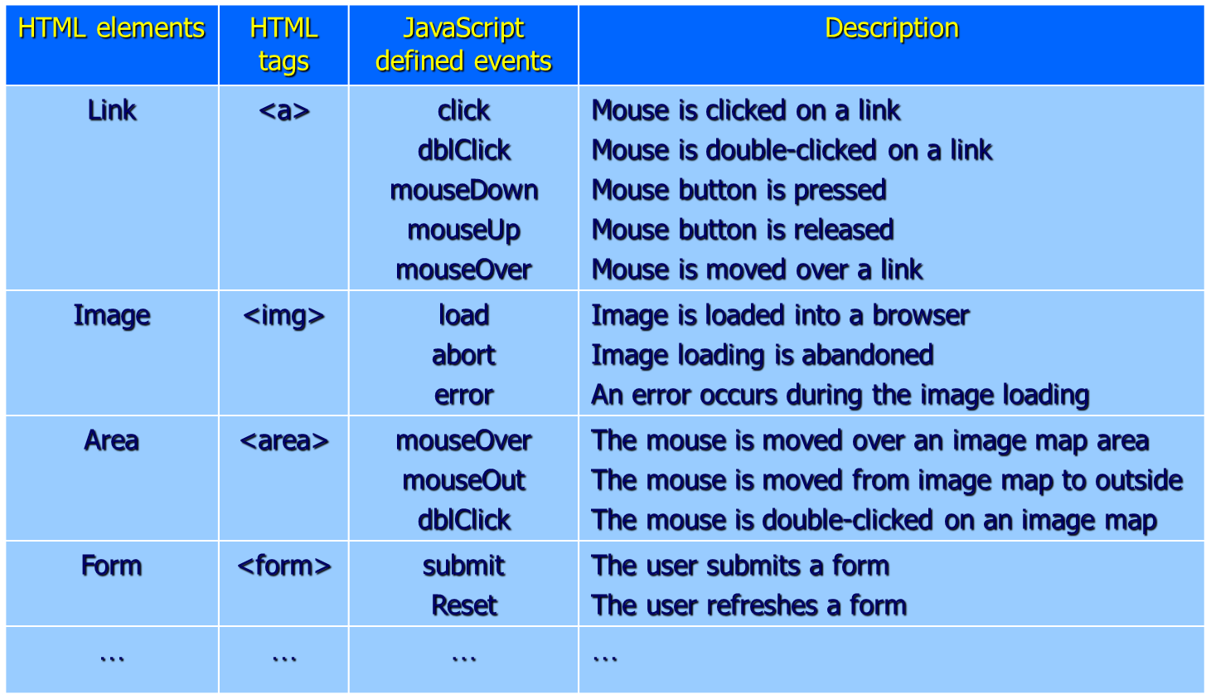
Event Types
CMPP 257: Introduction to JavaScript & JQuery

Slide 7
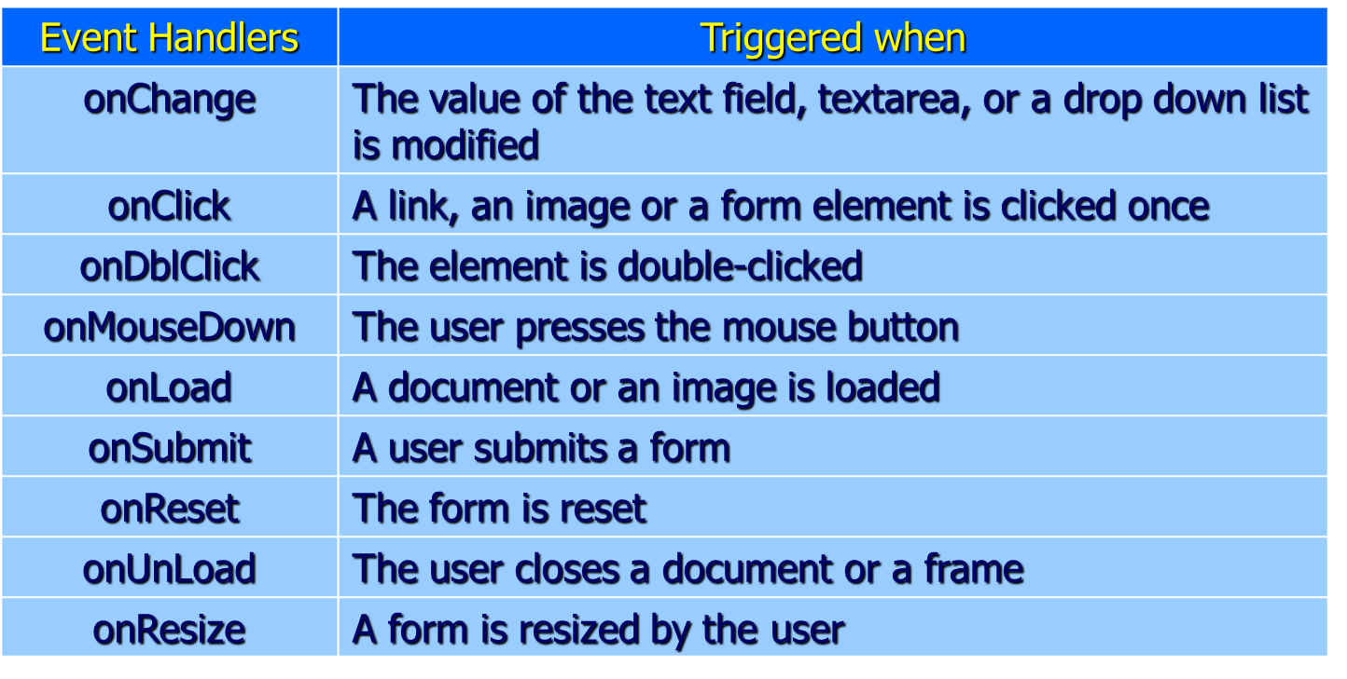
Event Handlers
CMPP 257: Introduction to JavaScript & JQuery

Slide 8

Event Handlers
Binding an Event to HTML Element
HTML Event Handler Attribute
Traditional DOM Event Handlers
DOM Level 2 Event Listeners
<HTML Tag eventHandler = “JS Code”>
JS Code → JS Statements or Function
<input type=“text” id=“username”
onblur=“checkUsername()”>
CMPP 257: Introduction to JavaScript & JQuery

Slide 9
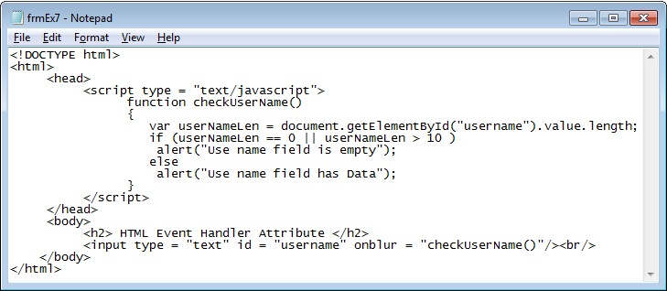
Event Handlers
CMPP 257: Introduction to JavaScript & JQuery

Slide 10
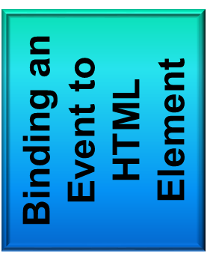
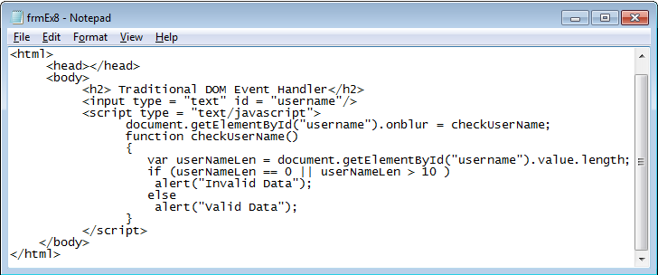
Event Handlers
Traditional DOM Event Handlers
el.onblur = checkUsername;
CMPP 257: Introduction to JavaScript & JQuery

Slide 11
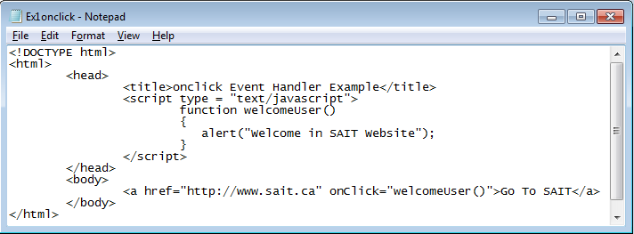
onClick Event Handler
CMPP 257: Introduction to JavaScript & JQuery

Slide 12
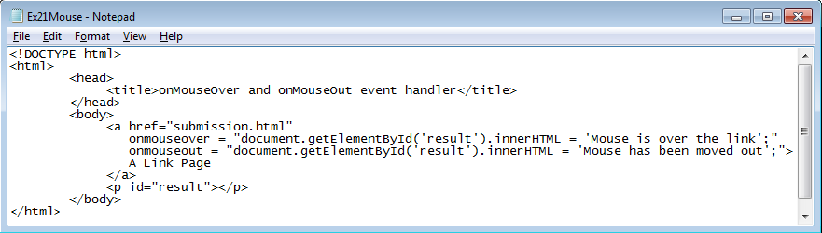
onmouseover & onmouseout
CMPP 257: Introduction to JavaScript & JQuery

Slide 13
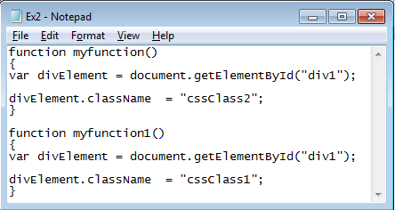
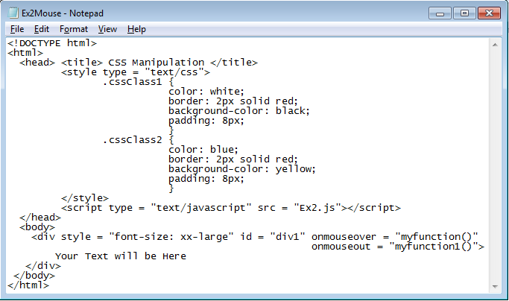
onmouseover & onmouseout
CMPP 257: Introduction to JavaScript & JQuery

Slide 14
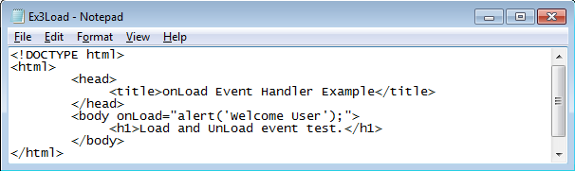
onload
Randomly Display Ads: C:\Users\hibrahim\Desktop\Dr.Hamdy\ConEd\CMPP257\MySlides\Week5-Events-Forms\Examples\banner
CMPP 257: Introduction to JavaScript & JQuery

Slide 15
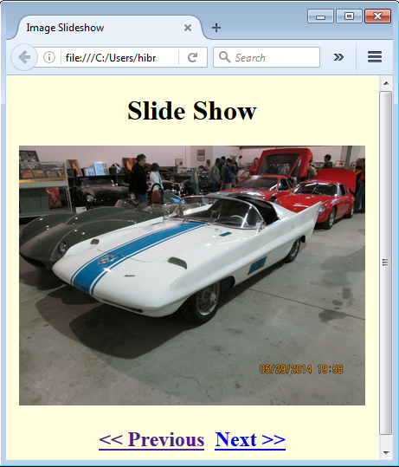
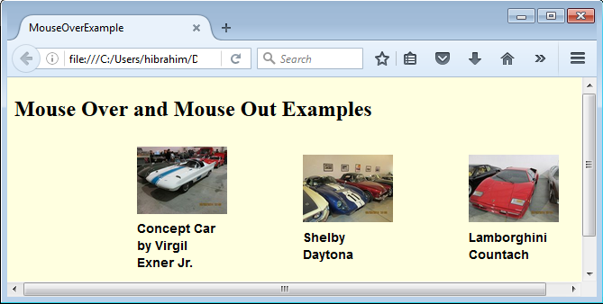
Event Handling
Task 1: Image Slider/Slide Show
Task 2: Images get bigger when you hover
CMPP 257: Introduction to JavaScript & JQuery

Slide 16
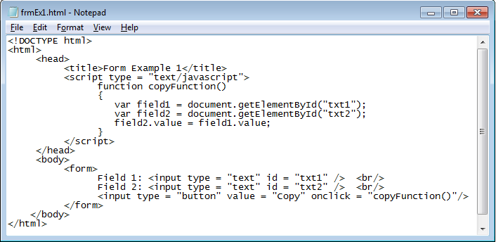
Form
Accessing Text Field Content
CMPP 257: Introduction to JavaScript & JQuery

Slide 17
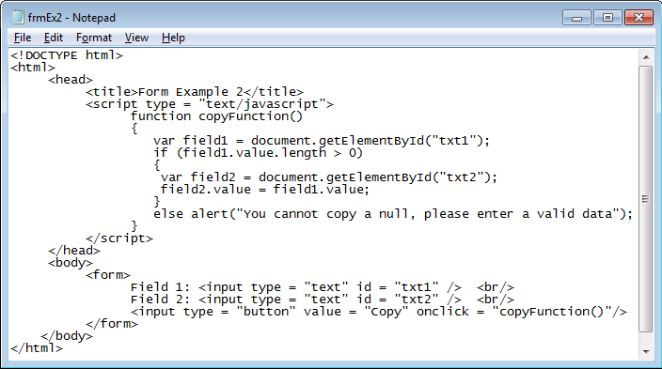
Form
Cannot Copy a Null
CMPP 257: Introduction to JavaScript & JQuery

Slide 18
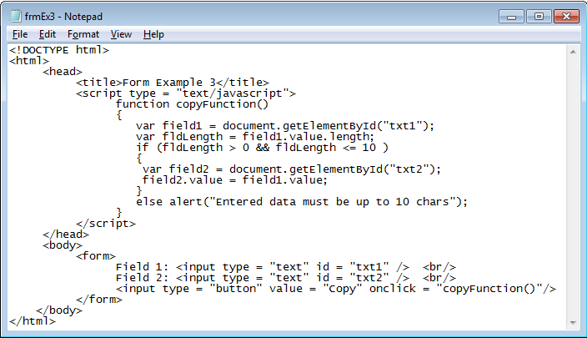
Form
Entered Data is up to 10 Chars
CMPP 257: Introduction to JavaScript & JQuery

Slide 19
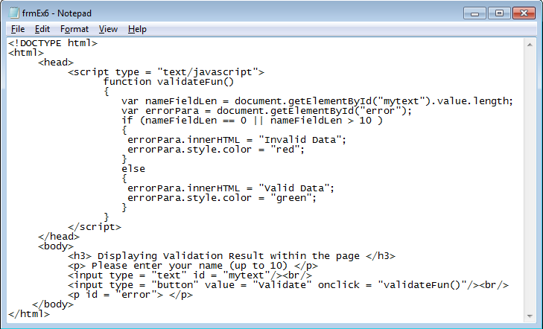
Form – Validation
Displaying Validation Result as a Part of the Page
CMPP 257: Introduction to JavaScript & JQuery

Slide 20
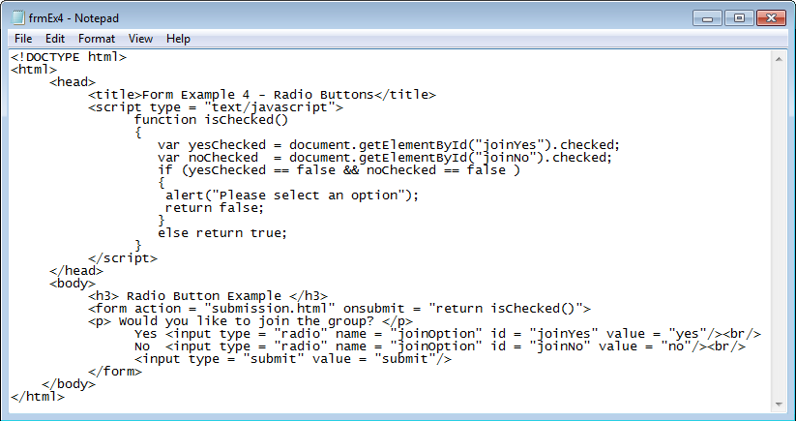
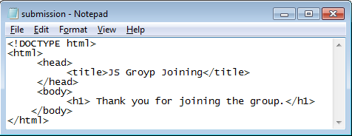
Form – Radio Buttons
Trace & guess its functionality
CMPP 257: Introduction to JavaScript & JQuery

Slide 21
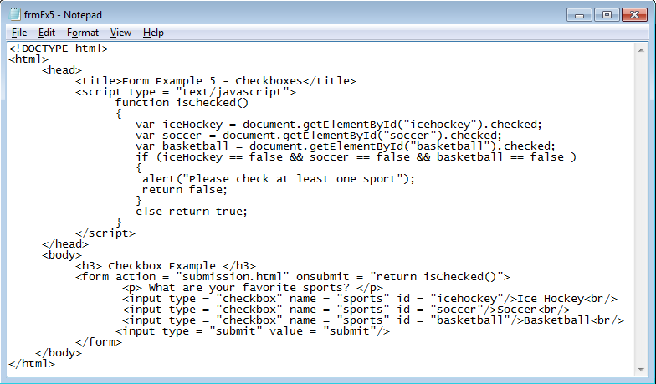
Form – CheckBox
Trace & guess its functionality
CMPP 257: Introduction to JavaScript & JQuery

Slide 22
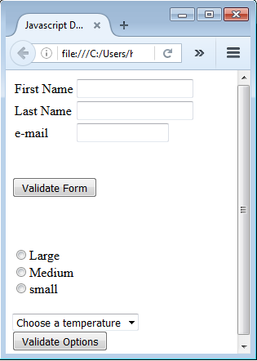

Form – Validation
Task 3: Validate Form Elements
Thank You
Questions?
CMPP 257: Introduction to JavaScript & JQuery

